Slide 1
Research Practice
Session-Mid-Sem
Routing attacks in Blockchain
YASHWANTH KOTHAKOTA - 2021H1030087H
ME CSIS 2021

Slide 2
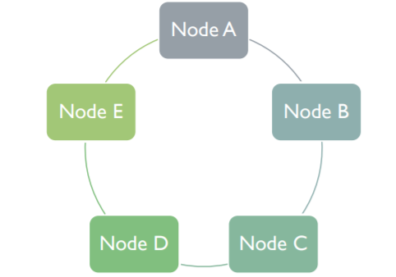
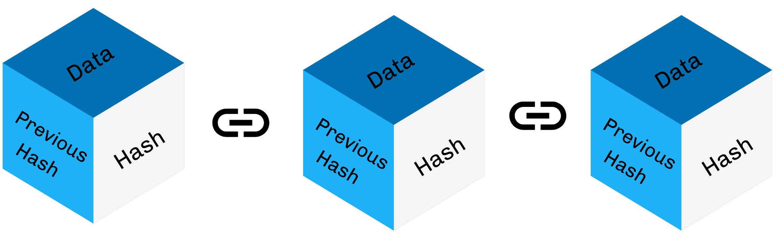
BLOCKCHAIN
Introduction
Distributed Ledger

Slide 3
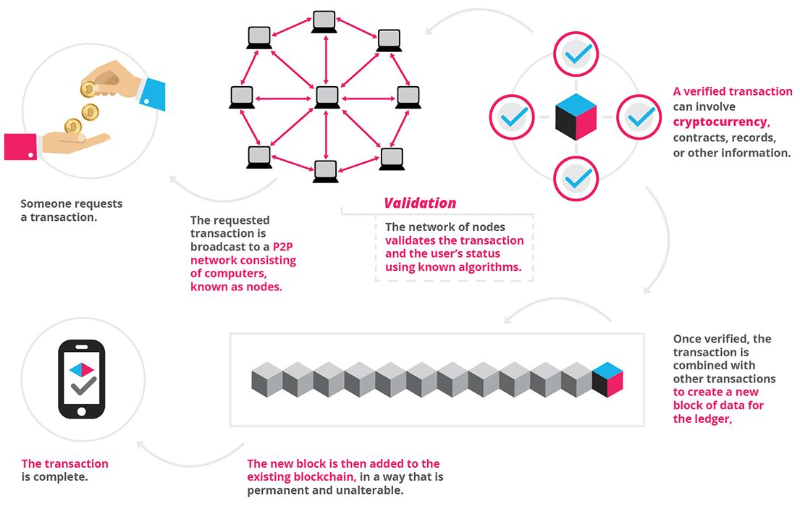
How Blockchain works?

Slide 4
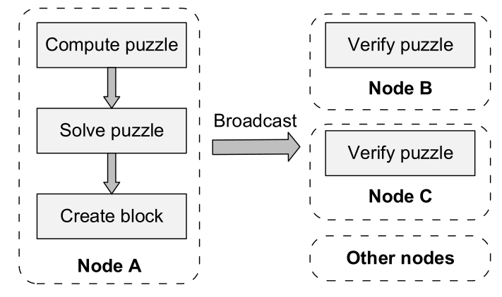
Overview of Blockchain technologies
Consensus mechanism
POW
POS

Slide 5
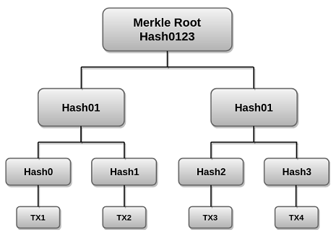
Overview of Blockchain technologies
Merkle tree
Hash23

Slide 6
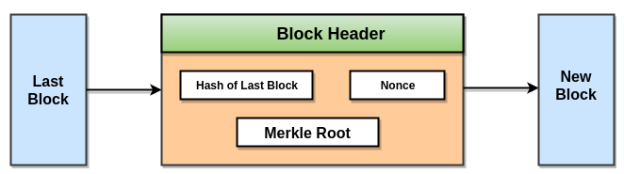
Overview of Blockchain technologies
Merkle tree

Slide 7


TECHNOLOGY DEVELOPMENT
BLOCKCHAIN 1.0 :-
Cryptocurrency
Characteristics:
Irreversible & Traceable
Decentralized & anonymous
Secure & permissionless
Fast & global
BLOCKCHAIN 2.0:-
Smart contracts
Characteristics:
Autonomy
Stable
Traceable
Secure

Slide 8
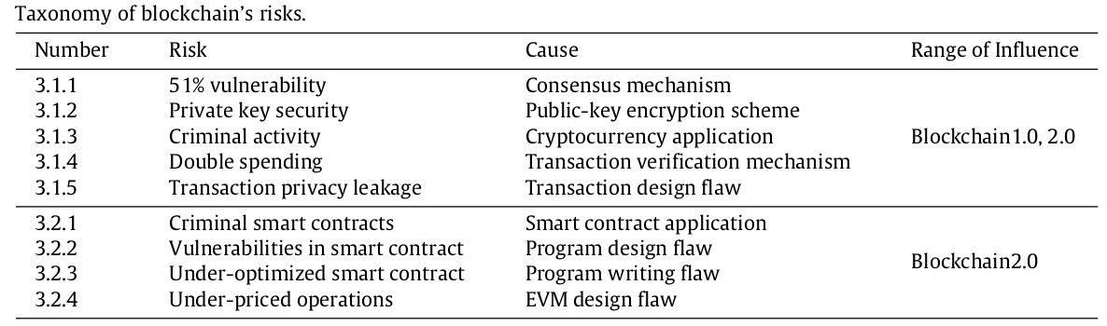
RISKS TO BLOCKCHAIN

Slide 9
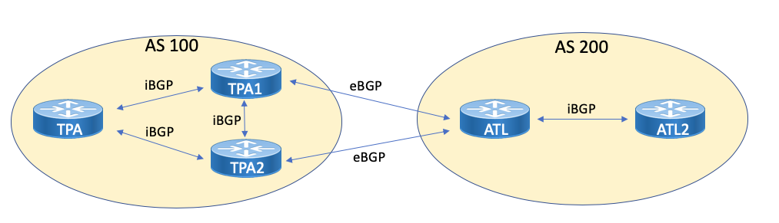
ATTACKS
Self mining attack
DAO attack
BGP hijacking attack

Slide 10
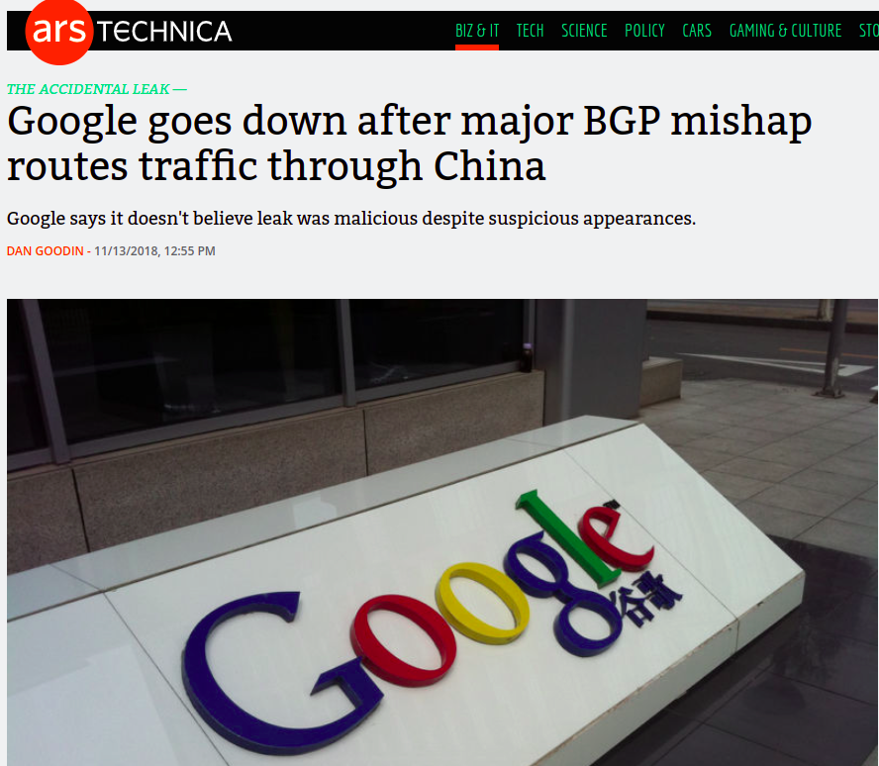
Source : arstechnica.com

Slide 11
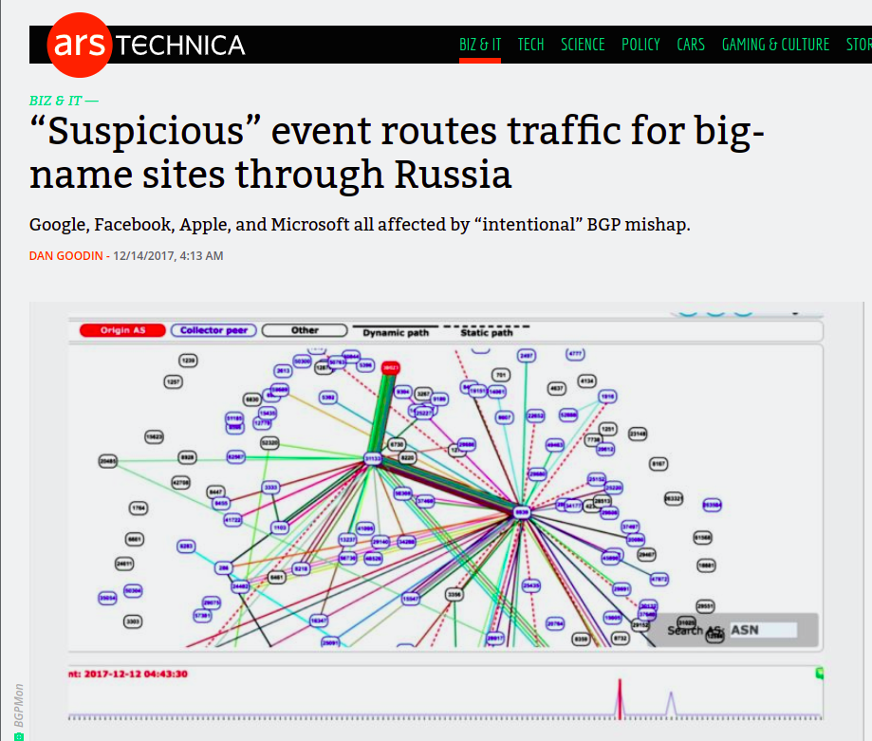
Source : arstechnica.com

Slide 12

CAN ROUTING ATTACKS IMPACT BITCOIN
Bitcoin is highly decentralized making it robust to routing attacks
Bitcoin nodes
Are scattered all around the world
Establish random connections
Use multihoming and relay networks

Slide 13
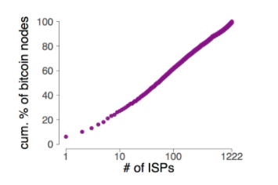
CAN ROUTING ATTACKS IMPACT BITCOIN
When come to practice, Bitcoin is highly centralized both from routing and mining point of view.
Mining power is centralized to few hosting networks
Source : https://btc-hijack.ethz.ch/

Slide 14
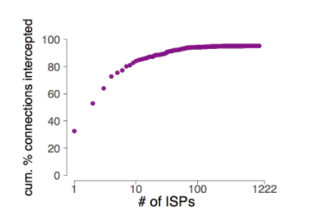
CAN ROUTING ATTACKS IMPACT BITCOIN
Also few ISPs can intercept large fraction of bitcoin connections
Source : https://btc-hijack.ethz.ch/

Slide 15
ATTACKS
Partitioning attacks - split the network into half
It is visible
It’s impact is network wide attack
Delay attacks - Delay block propogation
It is invisible
It’s impact - set of nodes

Slide 16
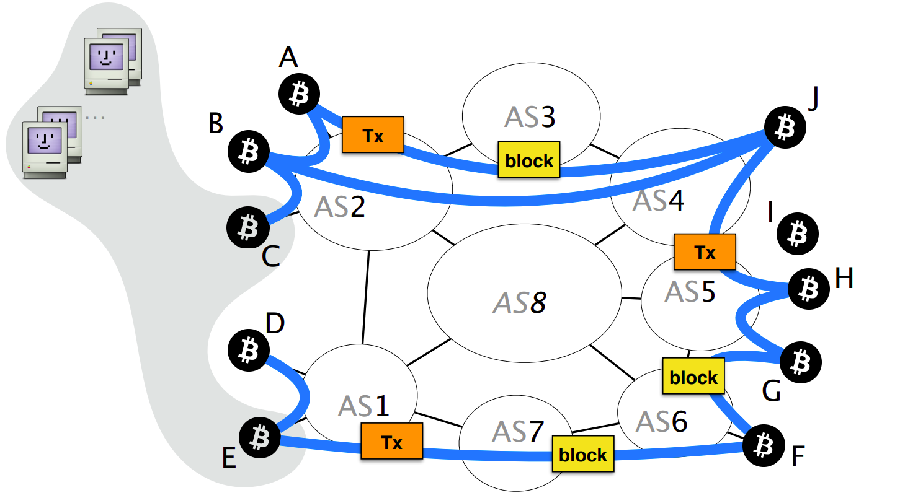
BACKGROUND OF BGP & BITCOIN
Source : Hijacking Bitcoin: Routing Attacks on Cryptocurrencies, https://btc-hijack.ethz.ch/

Slide 17
PARTITIONING ATTACKS
The main goal of partitioning network is to split Bitcoin network into two disjoint components.
Impact
Denial of service
Revenue loss
Double spending

Slide 18
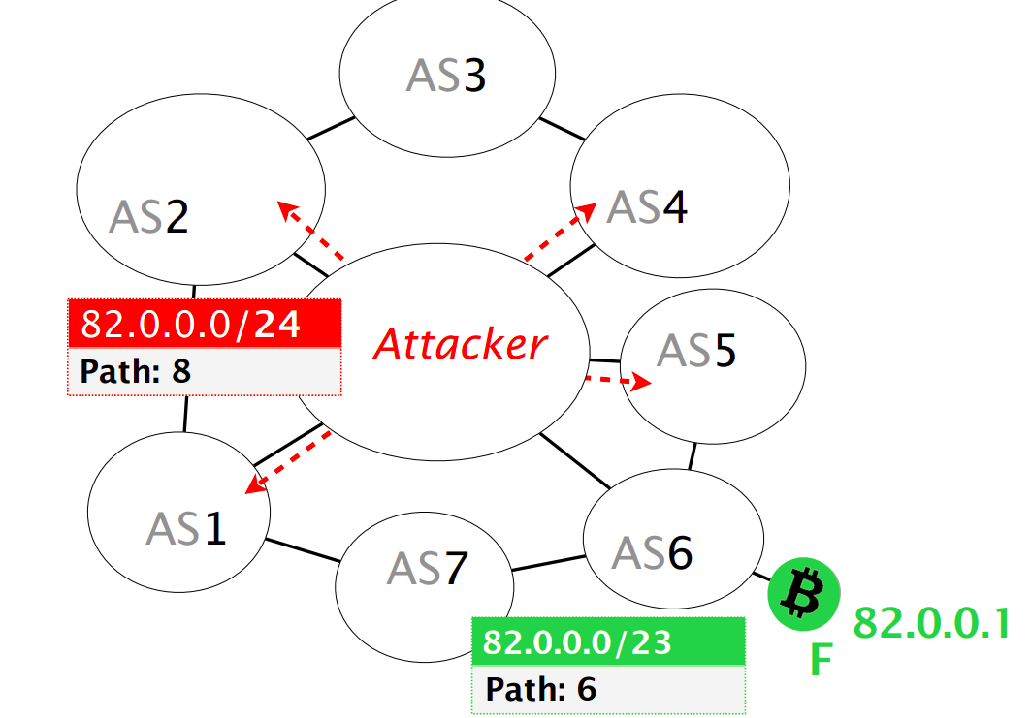
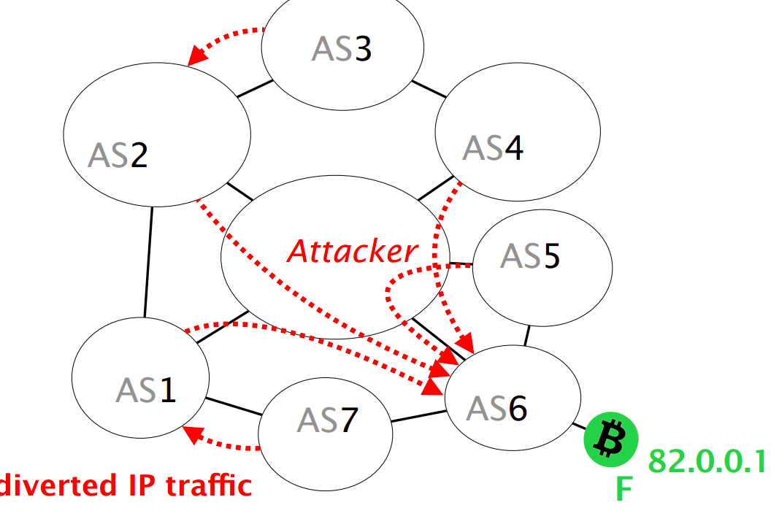
How does the attack work?
Assume there is node F and attacker decides to hijack it.
Source : Hijacking Bitcoin: Routing Attacks on Cryptocurrencies, https://btc-hijack.ethz.ch/

Slide 19
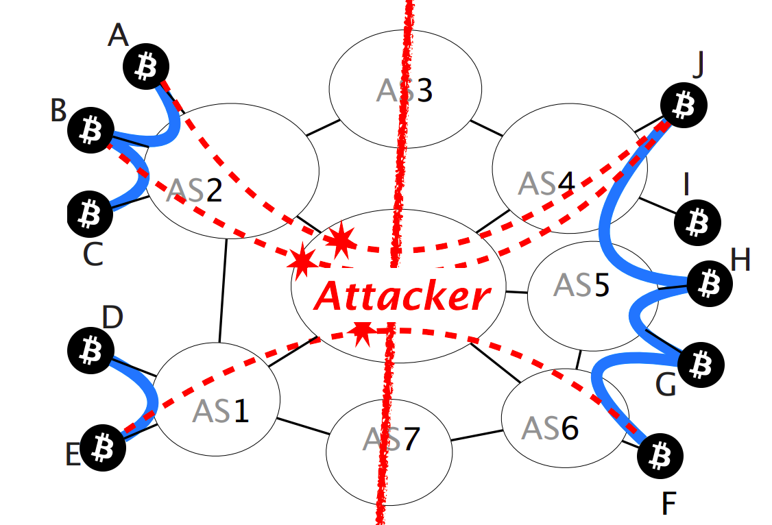
How does the attack work?
The attacker can drop all the connections crossing the partition. The partition is created.
Source : Hijacking Bitcoin: Routing Attacks on Cryptocurrencies, https://btc-hijack.ethz.ch/

Slide 20
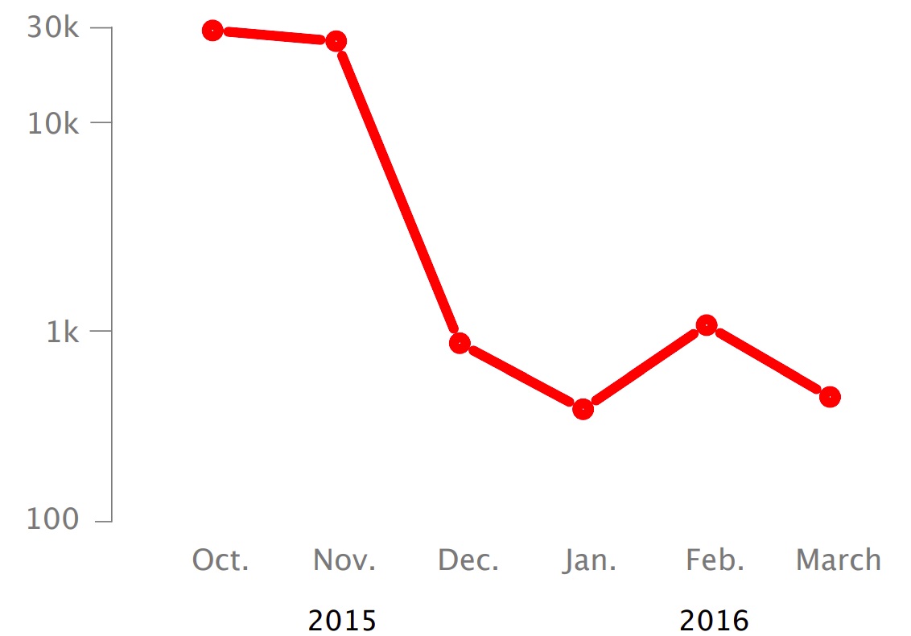
PARTITION ATTACK
Can it practically happen?
Splitting the mining power even to half can be done by hijacking less than 100 prefixes.
Hijacks involving upto 1k of prefixes are frequently seen in internet today.
Source : Hijacking Bitcoin: Routing Attacks on Cryptocurrencies, https://btc-hijack.ethz.ch/

Slide 21
DELAY ATTACK
The goal of delay attack is to make victim unaware of the latest block.
Impact
Double spending attacks
Wasting the mining power
Unable to be updated with peer-to-peer network
Source : Hijacking Bitcoin: Routing Attacks on Cryptocurrencies, https://btc-hijack.ethz.ch/

Slide 22
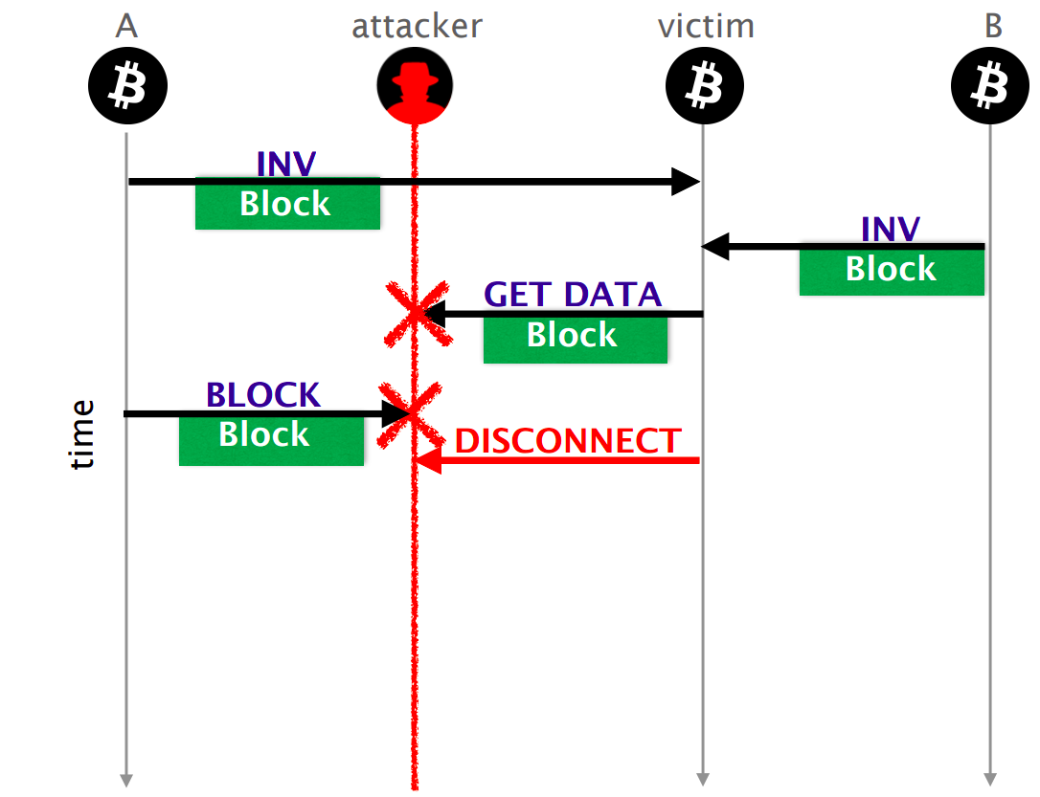
How does the attack work?
Source : Hijacking Bitcoin: Routing Attacks on Cryptocurrencies, https://btc-hijack.ethz.ch/

Slide 23
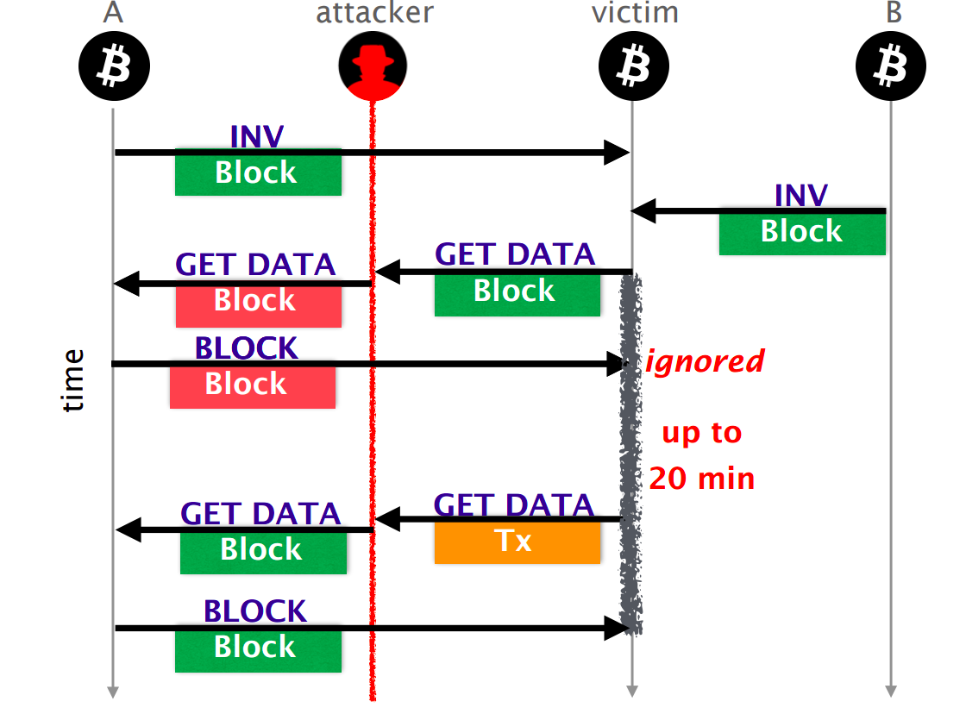
How does the attack work?
Source : Hijacking Bitcoin: Routing Attacks on Cryptocurrencies, https://btc-hijack.ethz.ch/

Slide 24
COUNTERMEASURES
Short term
Routing aware peer selection
Select Bitcoin peers while taking routing into account
Monitor changes in peer behaviour, statistics, etc.
Long term
Use end-to-end encryption
Not for partition attacks
Deploy secure routing protocols
Not for delay attacks
Source : Hijacking Bitcoin: Routing Attacks on Cryptocurrencies, https://btc-hijack.ethz.ch/

Slide 25
REFERENCES
Hijacking Bitcoin: Routing Attacks on Cryptocurrencies, https://btc-hijack.ethz.ch/
https://btc-hijack.ethz.ch/files/btc_hijack.pdf
https://www.youtube.com/watch?v=2RB-Gztfvpk&t=769s
https://btc-hijack.ethz.ch/#:~:text=An%20attacker%20can%20use%20routing,the%20creation%20of%20parallel%20blockchains.
https://www.youtube.com/watch?v=XAxfiaU0lzE
https://en.wikipedia.org/wiki/BGP_hijacking
https://www.educative.io/courses/hands-on-blockchain/
https://andersbrownworth.com/blockchain/public-private-keys/keys
https://andersbrownworth.com/blockchain/hash
A survey on the security of blockchain systems Xiaoqi Li, Peng Jiang, Ting Chen, Xiapu Luo a, Qiaoyan Wen, http://dx.doi.org/10.1016/j.future.2017.08.020.
Hijacking Bitcoin: Routing Attacks on Cryptocurrencies, https://btc-hijack.ethz.ch/

Slide 26

THANK YOU

